Slide 1
JAC444 - Lecture 2
Interfaces
Segment 2
Updated by: Mahboob Ali

Slide 2
Interfaces
In this segment you will be learning about:
Interfaces
Default methods, Private methods
Interface inheritance
Annotations
Functional interface

Slide 3
Interface Definition
Interface is a reference type in Java, similar to a class. It is a collection of abstract methods. An interface may also contain constants, default methods, static methods, and nested types. Interfaces cannot be instantiated, they can only be implemented by a class or extended by other interfaces.
interface InterfaceName { abstract method declaration(s)
constant(s) - final static fields default method(s)
static method(s) nested types
}
An interface creates a new reference data type, just as class definition
InterfaceName refVariable;

Slide 4
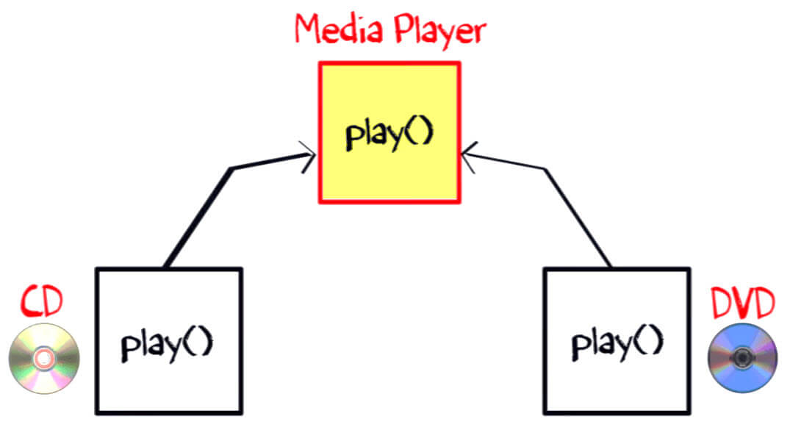
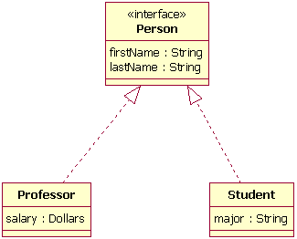

Slide 5
Interface Structure
All methods in an interface can be abstract methods, default methods and static methods.
( a method without implementation is an abstract method followed by a semicolon, but no braces)
All methods in an interface are implicitly public, so you can omit the modifier.
Variables declared in interface are public, static and final by default
Java 8 allows default method - method with implementation
Java 9 allows private method - improve code reusability (will allow common code to be extracted to methods that will remain encapsulated within the interface)

Slide 6
Interface Example
public interface Conversion { double INCH_TO_MM = 25.4; double inchToMM(double inches);
}
Conversion c;
// c is a reference of an object of type Conversion
public interface ConversionVersion2 { double INCH_TO_MM = 25.4;
double inchToMM(double inches); default public void defaultMethod() {
System.out.println("Special implementation");
}
}

Slide 7
Implementing an Interface
An interface defines a protocol of behavior.
A class obeys the protocol defined by interface by using the Java keyword implements
class MyConversion implements Conversion { double inchToMM(double inches) {
//implementation
}
}
Conversion c = new MyConversion(); double mm = c.inchToMM(…);

Slide 8
Private Method in Java 9
Java 7 has only: public abstract methods
Java 8 has: public static public default methods
Java 9 has: private method
The valid combinations:
public static public abstract public default private static
correct
correct
correct
correct
private abstract - compile error
private default private
compile error
correct

Slide 9
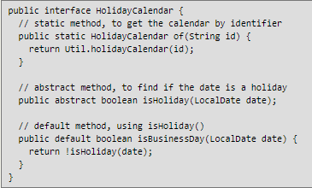
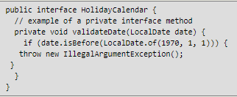
Java - 8
Java – 9 (Private methods addition in Interfaces)

Slide 10

Multiple Inheritance
Implementing Interface
interface Iable { void methodOne(); }
class First implements Iable { void methodOne() { … } }
Extending Interface
interface Jable extends Iable { String methodTwo(int i); } class Second implements Jable {
void methodOne() { … }
String methodTwo(int i) { … }
}
Interface Multiple inheritance
interface X extends A, B, C { … }

Slide 11
Marker Interface
A marker interface is an interface with no methods
(empty body)
interface Markable {
}
class Special implements Markable {
}
Markable obj = new Special();
Example: java.io.Serializable

Slide 12
Why Marker Interface and Use
Marker interface in Java e.g. Serializable, Clonnable and Remote, they are used to indicate something to compiler or JVM.
If JVM sees a Class is Serializable it done some special operation on it, similar way if JVM sees one Class is implement Clonnable it performs some operation to support cloning.
Some Uses of Marker Inerface
In short Marker interface indicate, signal or a command to Compiler or JVM.
Marker interface is a good way to classify code. You can create marker interface to logically divide your code. Particularly useful for developing API and framework like Spring or Struts.
One more use of marker interface in Java can be commenting. A marker interface called Thread Safe can be used to communicate other developers that classes implementing this marker interface gives thread-safe guarantee and any modification should not violate that.
In summary marker interface in Java is used to indicate something to compiler, JVM or any other tool but Annotation is better way of doing same thing.

Slide 13
Annotations
Data that provides information about other data is called metadata
Annotation is a language construct that provides metadata to Java source elements.
Classes, methods, variables, parameters and interfaces may be annotated
// Declares the annotation Important.
public @interface Important {
}
// @Important is an annotation to method say().
@Important
public String say(char c) {
}

Slide 14
In the simples form of it an annotation look like,
@Entity
The single character (@) tells the compiler that what follows after this is an annotation.
@Override
void mySuperMethod() {…..}

Slide 15
Functional Interface
A functional interface is an interface with an exactly one abstract method
interface Workable { String work(int j);
}
To emphasize that an interface is a Functional interface one can use annotation
@FunctionalInterface interface Workable {
String work(int j);
}

